Slide 1



TITANIC ANALYSIS DASHBOARD

Slide 2




Titanic Analysis Dashboard
Subtitle: Insights into Passenger Demographics and Survival
Presented by: Kareem Khaled Helmy

Slide 3
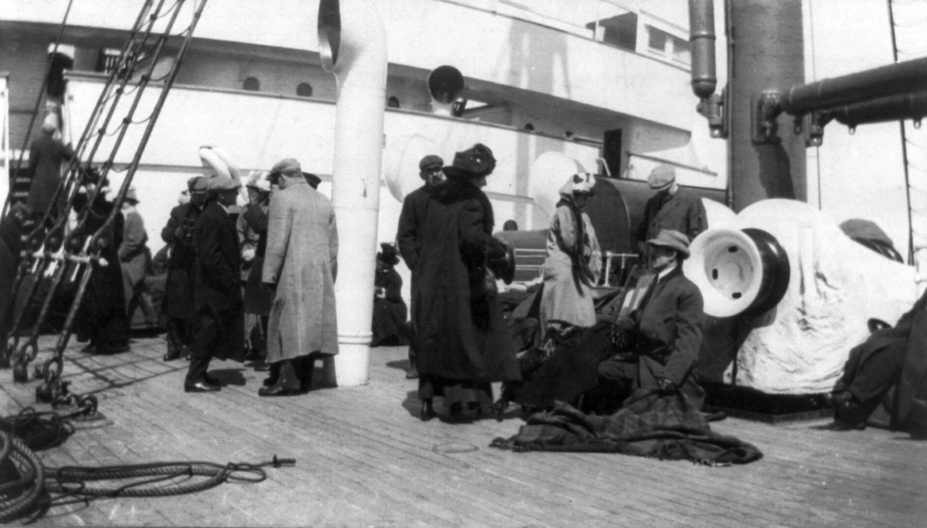
Overview
Analyze 1,000 Titanic passengers
Key metrics: survival, age, gender, family size, and embarkation point
Visual, interactive dashboard for deep insights

Slide 4

Key Metrics
Total Passengers: 1,000
Average Age: 38.5 years
Survived Passengers: 492
Not Survived Passengers: 508

Slide 5
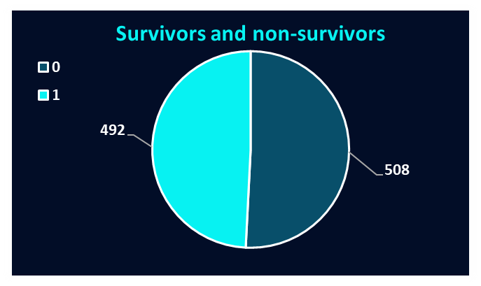
Survival Breakdown
Survivors: 492
Non-survivors: 508
Nearly even split, showcasing the disaster's severity

Slide 6

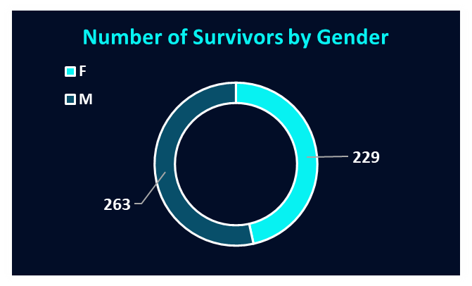
Gender-Based Survival
Males: 263
Females: 229
More male survivors, but deeper insights needed by age group

Slide 7

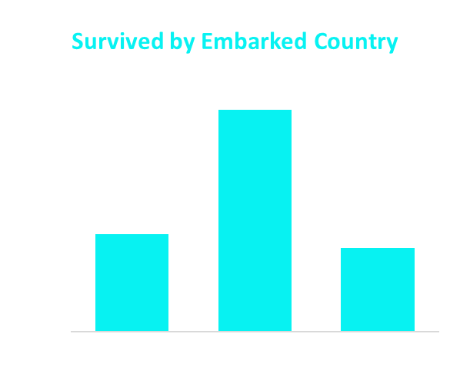

Survival by Embarkation Port
Port Q: 183
Port C: 156
Port S: 153
Queenstown (Q) had the highest survival count

Slide 8
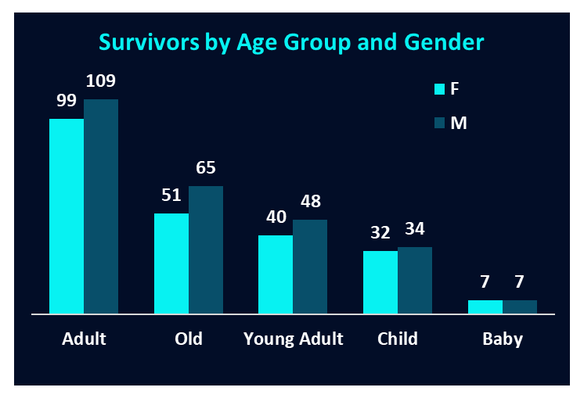
Survivors by Age Group and Gender
Adults: F = 99, M = 109
Old: F = 51, M = 65
Young Adult: F = 40, M = 48
Child: F = 32, M = 34
Baby: F = 7, M = 7
Adults were the most likely to survive

Slide 9
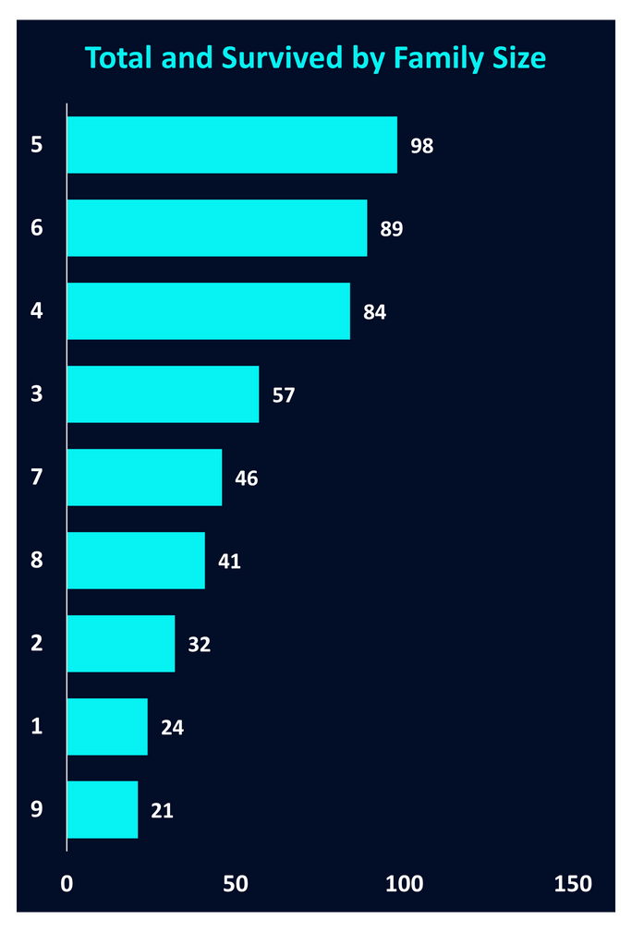
Challenges and Opportunities
Family sizes of 4 and 6 had higher survival
Larger sizes (8–9) had low survival rates

Slide 10
Filters and Interaction
Interactive filters:
Enables customized exploration
Survival status
Gender
Embarkation Port
Age Group

Slide 11

Conclusion
Dashboard highlights key survival trends
Age, gender, port, and family size all influenced outcomes
Tool is valuable for historical insights and decision-making models

Slide 12
THANK YOU

